Slide 1
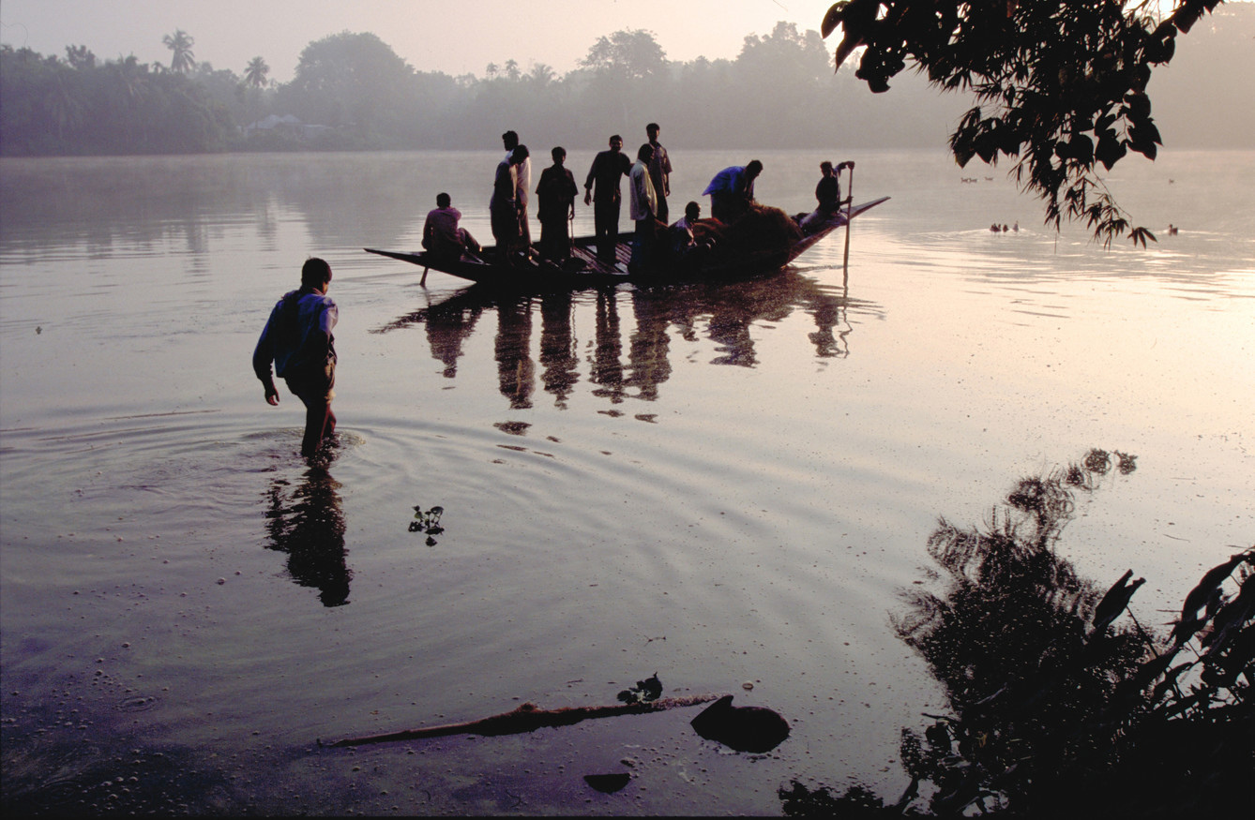
Quality Assurance Group (QAG)
The role of multilateral development organizations in promoting sustainable and inclusive rural transformation
With specific reference to the work of the International Fund for Agricultural Development and its contribution to meeting the Sustainable Development Goals
Ashwani K. Muthoo
Director, Quality Assurance Group
International Fund for Agricultural Development
6 April 2022, Keele University, UK

Slide 2
the multilateral development system is the totality of multilateral organizations that are mandated by their members and shareholders to promote international development.
What is multilateral development?
Source: OECD report on Multilateral Development Finance (2020)
Rapporto sui progressi
OSS 2025
01

Slide 3
Landscape of Multilateral Development Organizations (MDOs)
TYPE OF MDO
ROLE
EXAMPLES
UNDS consists of 34 entities that receive funds for development activities.
Mandates vary from service provision to policy development across sectors (health, education, environment, migration).
Funds and Programmes - UNDP, UNEP, UNICEF
Specialized agencies – WHO, WTO
Other – IAEA, UNHCR
UN Development System
Global, regional, sub-regional mandates.
Financial and technical assistance for low and middle income countries.
Receive multilateral ODA from bilateral donors.
Borrow from market to increase lending & grants
Multilateral development banks and International financial institutions
ADB, AfDB, NDB, World Bank
Multilateral climate and environment funds
Pool resources from public and private sector to address environment and climate needs.
GCF, GEF
RBA collaboration at global level on policy and advocacy to boost food security and nutrition.
In countries, RBAs support government efforts.
Thematic teams in areas like resilience, SSTC.
Rome Based Agencies
FAO, IFAD, WFP
Other inter-governmental organizations
Organizations with specialized mandates and governance structures
CGIAR
02

Slide 4
Role of MDOs in promoting sustainable and inclusive rural transformation
TRANSFER OF RESOURCES FOR DEVELOPMENT INITIATIVES
CONTRIBUTION TO POLICY REFORMS LEADING TO TRANSFORMATIONAL CHANGE
CAPACITY BUILDING
TECHNICAL ASSISTANCE
KNOWLEDGE SHARING
PROMOTION OF INNOVATIONS
SOUTH-SOUTH AND TRIANGULAR COOPERATION

Slide 5
What is rural transformation and why is it important?
Rural transformation involves rising agricultural productivity, marketable surpluses, diversification of production patterns and livelihoods.
It also involves expanded off-farm employment, improved access to services and infrastructure, and capacity to influence policy processes.
This leads to broad-based rural (and wider) growth, and sustainable rural landscapes.
Rural transformation is an important component of efforts to overcome poverty and hunger and achieve SDG 1 and SDG 2.
04

Slide 6
Why should we focus on sustainable and inclusive rural transformation?
Sustainability of benefits is fundamental for lasting prosperity
Focus on inclusive transformation is key to leaving no one behind
05

Slide 7
Millennium Development Goals (MDGs) produced a successful anti-poverty movement from 2000-15 and serve as the starting point for the sustainable development agenda.
Agenda 2030 was unanimously adopted by all member states of the UN in September 2015 at the UN Sustainable Development Summit.
2030 Agenda is a global commitment to leave no one behind and calls for action by all countries.
Goal is to eradicate poverty and hunger and put societies on a sustainable path.
2030 Agenda features 17 SDGs, which recognize that ending poverty goes hand-in-hand with strategies that foster economic growth and address social needs.
Sustainable Development Goals
(1/2)
07
06

Slide 8
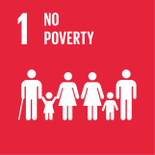
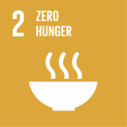
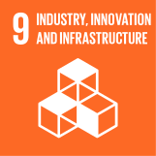
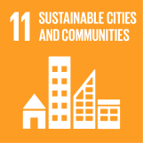
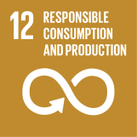
Sustainable Development Goals
(1/2)

Slide 9
Why is rural transformation important for achieving the SDGs?
Rural transformation is a process in which rising agricultural productivity, commercialization, off-farm employment, better services and infrastructure, and capacity to influence policy lead to improved rural livelihoods and inclusive growth
This is key to achieving SDG 1 and SDG 2
08

Slide 10
IFAD as a multilateral development organization:
Basic facts
Established in the mid-1970s, IFAD is a specialized UN agency and an International Financial Institution
Provision of concessional loans and grants for development projects and programmes in agriculture and rural development
Projects and programmes implemented by Governments and other in country partners
IFAD operations cover all geographic regions
IFAD headquarters is in Rome and there are 51 regional / country offices
177 member states
Evolving financial architecture
Since 1978, IFAD has provided US$23.2 billion in grants and a total of 1,142 low-interest loans to fund projects in developing countries reaching an estimated 518 million people
09

Slide 11
IFAD Strategic Framework
STRATEGIC OBJECTIVES (SOs)
STRATEGIC VISION
Inclusive and sustainable rural transformation
OVERARCHING GOAL
Poor rural people overcome poverty and achieve food security through remunerative, sustainable and resilient livelihoods
Increase poor rural people’s productive capacities
SO 1
Increase poor rural people’s benefits from market participation
SO 2
Strengthen environmental sustainability and climate resilience of poor rural people’s economic activities
SO3
10

Slide 12
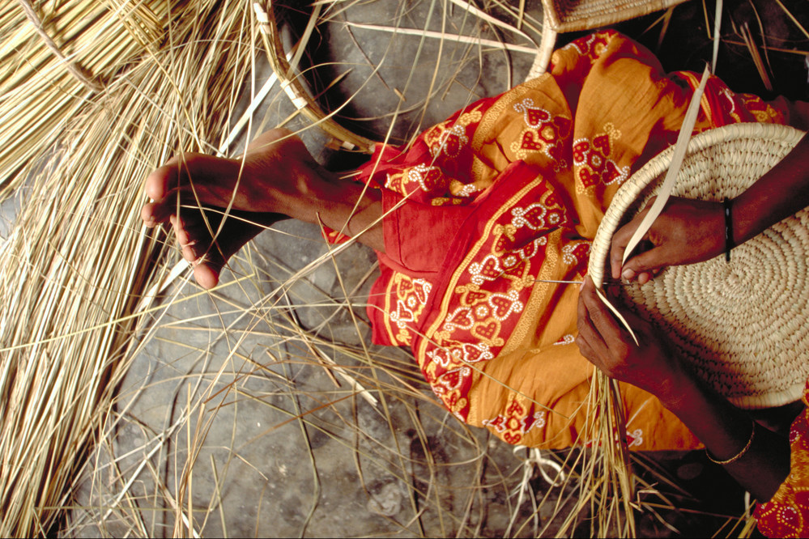
IFAD’s role in sustainable and inclusive rural transformation
Focus entirely on assisting the “poorest of the poor”
Clear targeting strategy (marginalized people, women, youth, indigenous peoples, ethnic minorities, people with disabilities).
Guiding principles: Bottom up and participatory development approaches, partnerships and innovation
11

Slide 13
IFAD’s priorities and how they contribute to rural transformation
Youth
Focus on skill development and job creation
Women
Gender transformative approaches aim to ensure equal access to productive assets and services by addressing social norms
Climate
Considerations include access to new and affordable technologies
Mainstreaming priorities
Targeted actions to overcome barriers faced by rural poor and other vulnerable groups
Nutrition
Encouraging production and consumption of nutritious foods
People with disabilities
Assisting them in setting up new ventures
Indigenous peoples
Community driven approach suited to their needs

Slide 14
IFAD: Selected lessons learned
Importance of comprehensive poverty analysis
Need for context specific and customized operations
Limit complexity and ambition of designs
Investing in monitoring and evaluation to promote accountability and learning
Leverage public-private partnerships in rural areas
13

Slide 15
Key priorities for sustainable and inclusive rural transformation
Digital infrastructure and technologies
Access to capital through strengthened rural financial services and products
Climate smart agricultural interventions
Improved technology for enhancing agriculture production and productivity
Off farm employment, value addition and market access

Slide 16
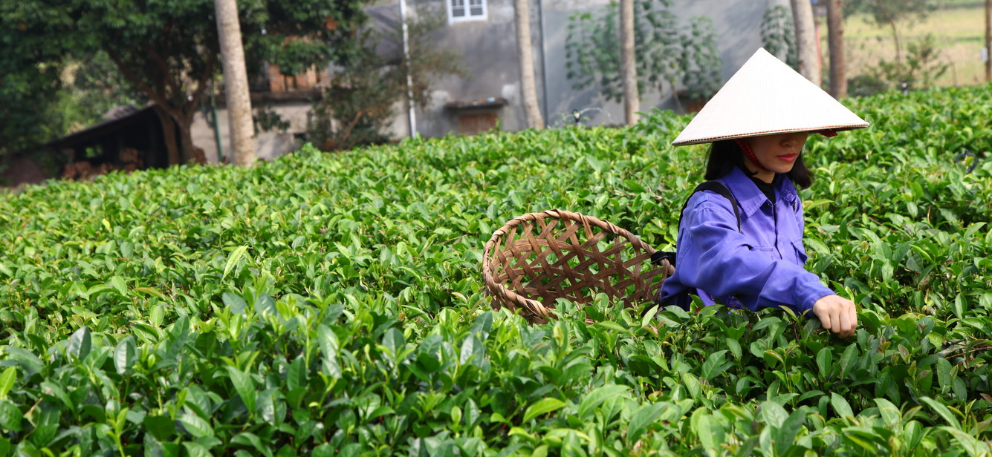
IFAD in Vietnam - Mobile app answers to climate change
Video clip on using an app to help tackle climate change in Vietnam
15

Slide 17
Thank You

